Slide 1


Macroeconomics
Ninth Edition
Chapter 12
Aggregate Expenditure and Output in the Short Run
Copyright © 2025, 2021, & 2018 Pearson Education, Inc. All Rights Reserved
Notes:
If this PowerPoint presentation contains mathematical equations, you may need to check that your computer has the following installed:
1) MathType Plugin
2) Math Player (free versions available)
3) NVDA Reader (free versions available)

Slide 2
Chapter Outline
12.1 The Aggregate Expenditure Model
12.2 Determining the Level of Aggregate Expenditure in the Economy
12.3 Graphing Macroeconomic Equilibrium
12.4 The Multiplier Effect
12.5 The Aggregate Demand Curve
Appendix The Algebra of Macroeconomic Equilibrium

Slide 3

Glamping and Airstream’s Ride on the Business Cycle
Elkhart County, I N, experiences the ups and downs of the business cycle more than most.
More than 80 percent of U.S. R V s are manufactured there, and R V sales rise during economic expansions and fall sharply during recessions.
Unemployment in the county swung from 2.7 percent in March 2020 to 28.6 percent after the Covid-19 shutdown.
But with foreign travel unavailable, demand for R V s surged, before declining again with the high interest rates in 2023.

Slide 4
12.1 The Aggregate Expenditure Model
Explain how macroeconomic equilibrium is determined in the aggregate expenditure model.
In this chapter, we will build up a simple mathematical model of the economy known as the aggregate expenditure model.
Aggregate expenditure model: A macroeconomic model that focuses on the short-run relationship between total spending and real G D P, assuming that the price level is constant.
This model will focus on short-run determination of total output in an economy.

Slide 5
Four Components of Aggregate Expenditure
The four components in our model will be the same four that we introduced previously as the components of G D P:
Consumption (C): Spending by households on goods and services
Planned investment (I): Planned spending by firms on capital goods and by households on new homes
Government purchases (G): Spending by all levels of government on goods and services
Net exports (N X): The value of exports minus the value of imports
Aggregate expenditure (A E) is total spending in the economy: the sum of consumption, planned investment, government purchases, and net exports.

Slide 6
The Difference between Planned Investment and Actual Investment
Our aggregate expenditure model uses planned investment, rather than actual investment; in this way, the definition of aggregate expenditures is slightly different from G D P.
The difference is that planned investment spending does not include the build-up of inventories: goods that have been produced but not yet sold:
Although the Bureau of Economic Analysis (B E A) measures actual investment, we will assume that their measurement is close enough to planned investment to use in our estimates of aggregate expenditures.

Slide 7
Table 12.1 The Relationship Between Actual and Planned Investment
If … | then …
the economy does not experience an unplanned change in inventories, | actual investment equals planned investment.
the economy experiences an unplanned increase in inventories, | actual investment will be greater than planned investment.
the economy experiences an unplanned decrease in inventories, | actual investment will be less than planned investment.
For example, Doubleday Publishing may print 1.5 million copies of the latest John Grisham novel, expecting to sell them all.
If Doubleday does sell all 1.5 million, its inventories will be unchanged, but if it sells only 1.2 million, it will have an unplanned increase in inventories.

Slide 8
Macroeconomic Equilibrium
Equilibrium in the economy occurs when spending on output is equal to the value of output produced; that is:
This should look “obvious”:
The difference is that in the first equation, I is planned investment, whereas in the second, I is actual investment.
So, macroeconomic equilibrium occurs when planned investment equals actual investment, that is, no unplanned change in inventories.

Slide 9
Table 12.2 The Relationship between Aggregate Expenditure and G D P
If … | then … | and …
aggregate expenditure is equal to G D P, | inventories are unchanged, | the economy is in macroeconomic equilibrium.
aggregate expenditure is less than G D P, | inventories rise, | G D P and employment decrease.
aggregate expenditure is greater than G D P, | inventories fall, | G D P and employment increase.
Just like markets for a particular product may not be in equilibrium (quantity supplied may not equal quantity demanded at the current price), the economy may not be in equilibrium.
The table summarizes how the economy adjusts to macroeconomic equilibrium.

Slide 10
12.2 Determining the Level of Aggregate Expenditure in the Economy
Discuss the determinants of the four components of aggregate expenditure and define marginal propensity to consume and marginal propensity to save.
Each of the components of aggregate expenditure plays a different role in the determination of equilibrium aggregate expenditure.
We will explore them in this section.
Throughout this chapter, all values are in real terms rather than nominal.
Values are in billions of 2017 dollars.

Slide 11
Table 12.3 Components of Real Aggregate Expenditure, 2022
Expenditure Category | Real Expenditure (billions of 2017 dollars)
Consumption | $15,091
Planned investment | 4,103
Government purchases | 3,670
Net exports | negative 1,051
The table shows the values of the components of expenditure in 2022.
Consumption is the largest portion, with investment and government expenditures being roughly similarly sized.
Net exports were negative in 2022; the value of U.S. imports was greater than the value of U.S. exports.

Slide 12
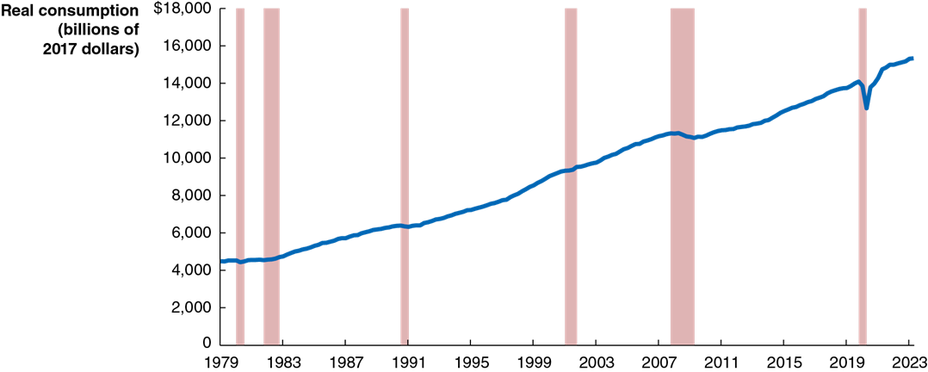
Figure 12.1 Real Consumption, 1979–2023
Consumption tends to follow a relatively smooth, upward trend; its growth declines during periods of recession.
What affects the level of consumption?
Current disposable income
Household wealth
Expected future income
The price level
The interest rate
Notes:
NOTE: In the digital chapter, The Figure 12.1 is an interactive real-time data graph, which means it automatically updates when new data becomes available.
The horizontal axis represents years, and ranges from 1979 to 2023, in increments of 5 years. The vertical axis represents real consumption, in billions of 2017 dollars, and ranges from 0 to $18,000, in increments of 2,000. The area for recession periods, 1980 to 1981, 1982 to 1983, 1990 to 1991, 2001 to 2002, 2007 to 2009, and 2020 are shaded. The line starts at 4,200 in 1979, rises through 6,000 in 1991, 10,000 n 2007, reaches 13,000 in 2020, falls to 11,000 by the end of 2020, and ends at 15,000 in 2023. All values are estimated.

Slide 13
Determinants of Consumption (1 of 2)
Current disposable income
Consumer expenditure is largely determined by how much money consumers receive in a given year:
Income expands most years; hence so does consumption.
Household wealth
A household’s wealth can be thought of as its assets (like homes, stocks and bonds, and bank accounts) minus its liabilities (mortgages, student loans, etc.).
Households with greater wealth spend more on consumption; an extra $1,000 in wealth will result in $40–$50 in extra annual consumption spending, holding constant the effect of income.

Slide 14
Determinants of Consumption (2 of 2)
Expected future income
Most people prefer to keep their consumption fairly stable from year to year even if their income fluctuates a lot from year to year.
So, consumption relates both to current and future income.
The price level
As prices rise, household wealth falls. Consequently, higher prices result in lower (real) consumption spending.
The interest rate
Higher real interest rates encourage saving rather than spending, so they result in lower spending, especially on durable goods.

Slide 15
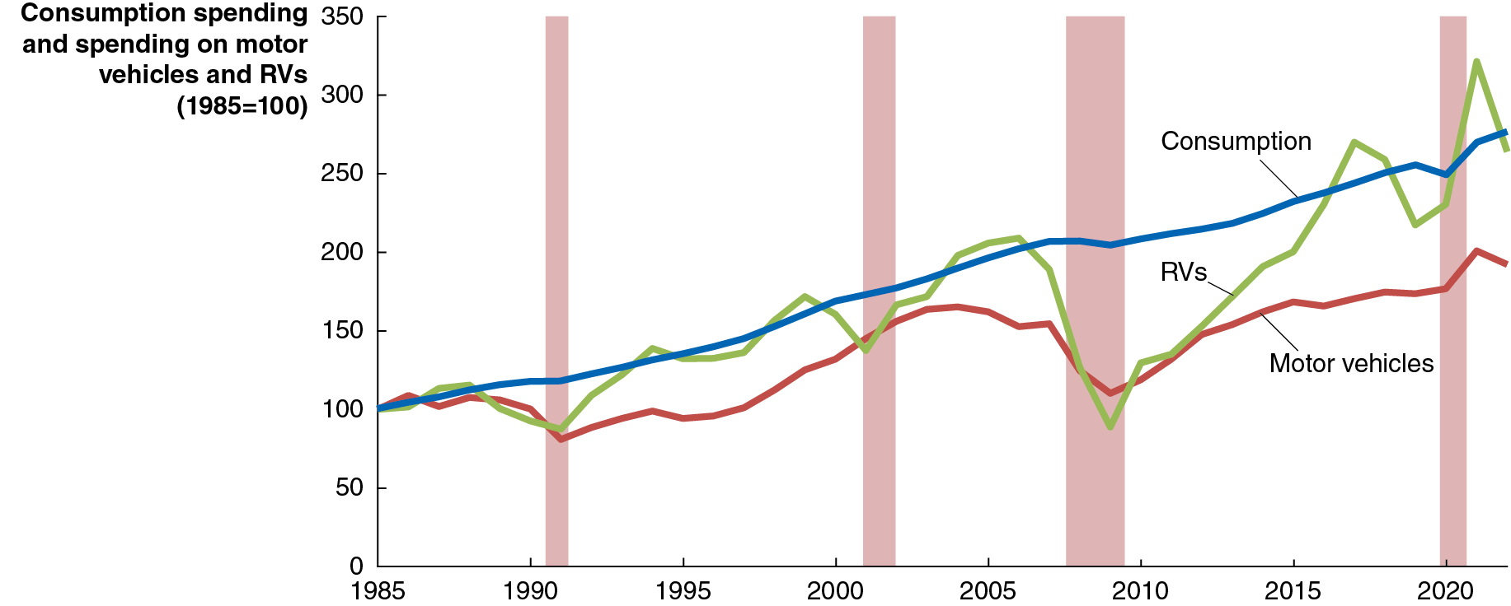
Figure 12.2 Real Consumption and Spending on Motor Vehicles and R Vs, 1985–2022
Household spending on all consumption goods is less volatile than spending on consumer durables like motor vehicles (cars and trucks) or recreational vehicles (R V s).
The consumption of other consumer durables behaves similarly.
Notes:
NOTE: In the digital chapter, The figure 12.2 is an interactive real-time data graph, which means it automatically updates when new data becomes available.
The X axis represents year, and the Y axis represents consumption spending and production of motor vehicles and R V’s, where 1985 = 100. The recession periods 1991, 2001, 2008 to 2010, and 2020 are shaded. Three plots represent consumption, motor vehicles, and R V’s, respectively. Each rises and falls irregularly across the graph with general upward trends as follows.
• Consumption rises from 100 in 1985 to 259.3 in 2019, then falls to 249.3 in 2021.
• Motor vehicles falls from 100 in 1985 to 80.9 in 1991, 165.2 in 2004, falls to 110.2 in 2009, then rises to 174.8 in 2020.
• R V’s falls from 100 in 1985 to 87.4 in 1991, 171.9 in 1999, falls to 137.4 in 2001, rises to 208.9 in 2006, falls to 88.7 in 2009, rises to 270 in 2017, falls to 217.2 in 2019, then rises to 230.3 in 2020.

Slide 16
The Volatility of Consumer Spending on Durables
Why is spending on durable goods like cars and R Vs so volatile?
Durable goods are long-lived—households can postpone buying them when incomes are down.
Good substitutes exist—like used cars/R Vs.
High prices make them risky purchases—in times of uncertainty, the risk of not being able to pay back loans is important for consumers.
Pent-up demand typically follows a recession—purchases postponed during a recession will eventually be made.
Interest rates fluctuate—rising late in an expansion (discouraging large purchases) and falling during and after a recession (encouraging those purchases).

Slide 17
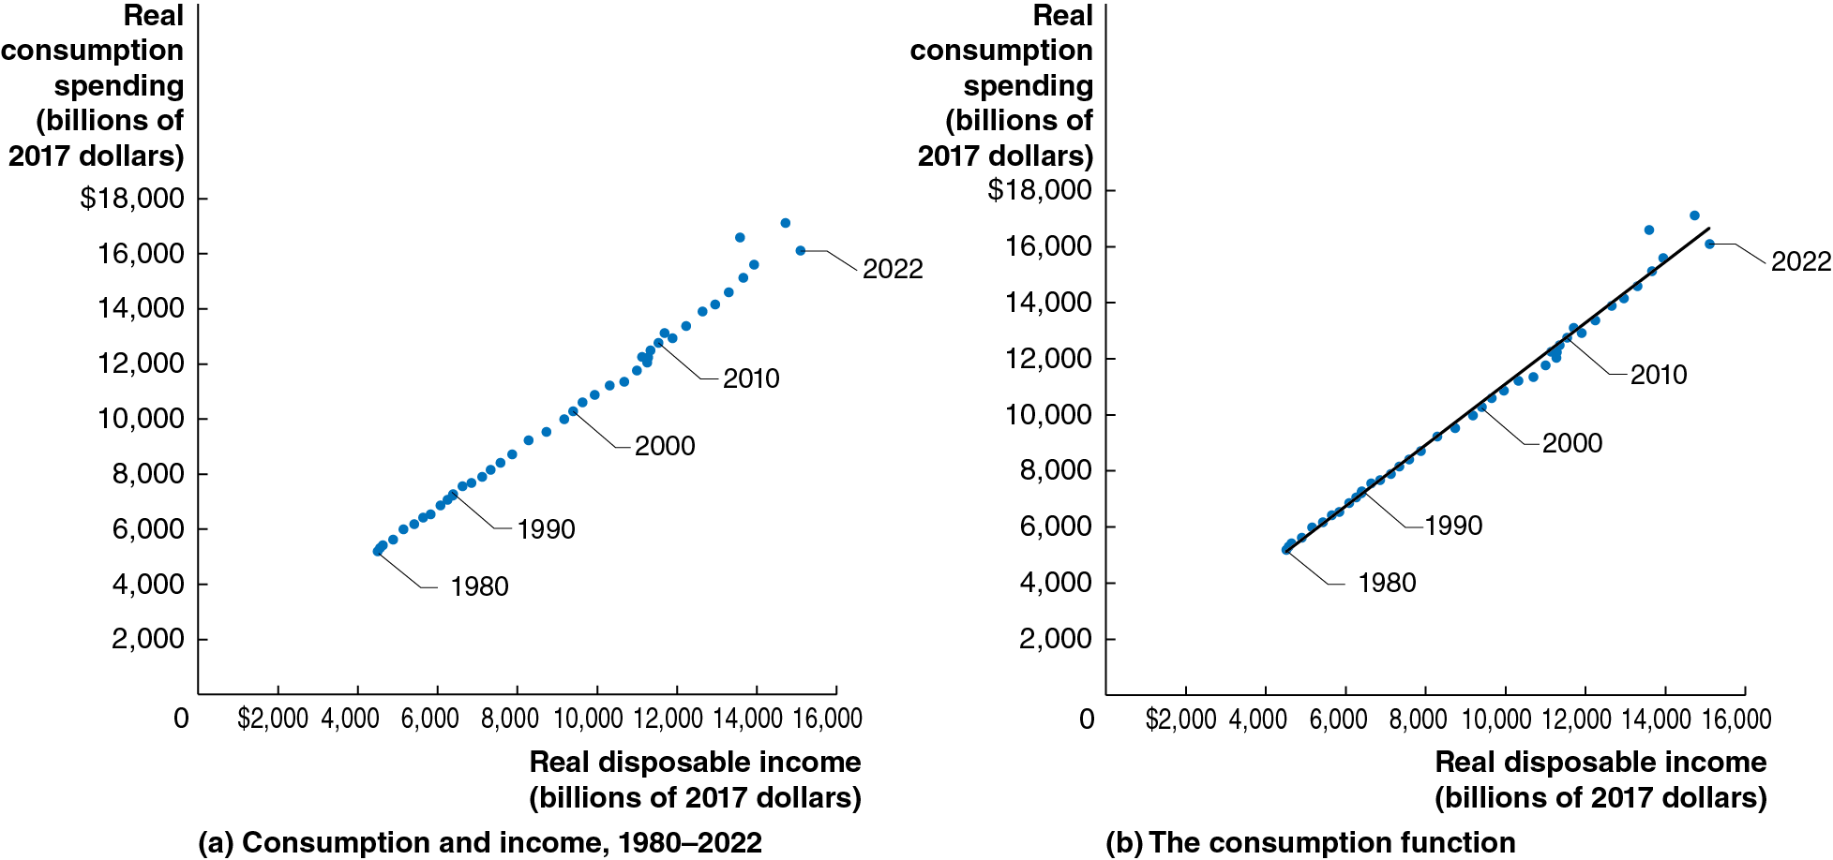
Figure 12.3 The Relationship between Consumption and Income, 1980–2022
The relationship between consumption and income is very strong. A straight line describes this consumption function very well: households spend a consistent fraction of each extra dollar on consumption.
Consumption function: the relationship between consumption spending and disposable income.
Notes:
On both graphs, the horizontal axis represents real disposable income in billions of 2017 dollars, and ranges from 0 to $16,000, in increments of $2,000. The vertical axis represents real consumption spending in billions of 2017 dollars, and ranges from 0 to $18,000, in increments of $2,000.
(a) The graph depicts consumption and income between 1980 to 2022. A line of plotted points rises through the graph from (4,500, 5,000) in 1980, to (9,000, 9,000) in 2000, and (16,000, 15,000) in 2022.
(b) The graph depicts the consumption function. A line of plotted points rises through the graph from (5,000, 5,000) in 1980, to (10,500, 10,000) in 2000, and (15,500, 15,000) in 2022. A line has been added where early points then fall above or along the line, and points after 1990 fall under the line, and move over the top again before 2018. All values are estimated.

Slide 18
Marginal Propensity to Consume
The graphs showed that consumers seem to have a relatively constant marginal propensity to consume.
Marginal propensity to consume (M P C): The slope of the consumption function: the amount by which consumption spending changes when disposable income changes.
The marginal propensity to consume is the slope of the consumption function.

Slide 19
Estimating the M P C
We can estimate the M P C by estimating the slope of the consumption function:
From 2017 to 2018, consumption increased by $364 billion, while disposable income increased by $530 billion:
We can use this to tell us the change in consumption to expect from a given change in income, say $10 billion:

Slide 20
Consumption and National Income
The distinction between national income and G D P is relatively minor; for this simple model, we will assume they are equal and use the terms interchangeably. Since:
where “net taxes” are equal to taxes minus transfer payments, we can write:
If we assume that net taxes do not change as national income changes, we have the result that any change in disposable income is the same as the change in national income.
We will use this in the graph on the next slide.

Slide 21
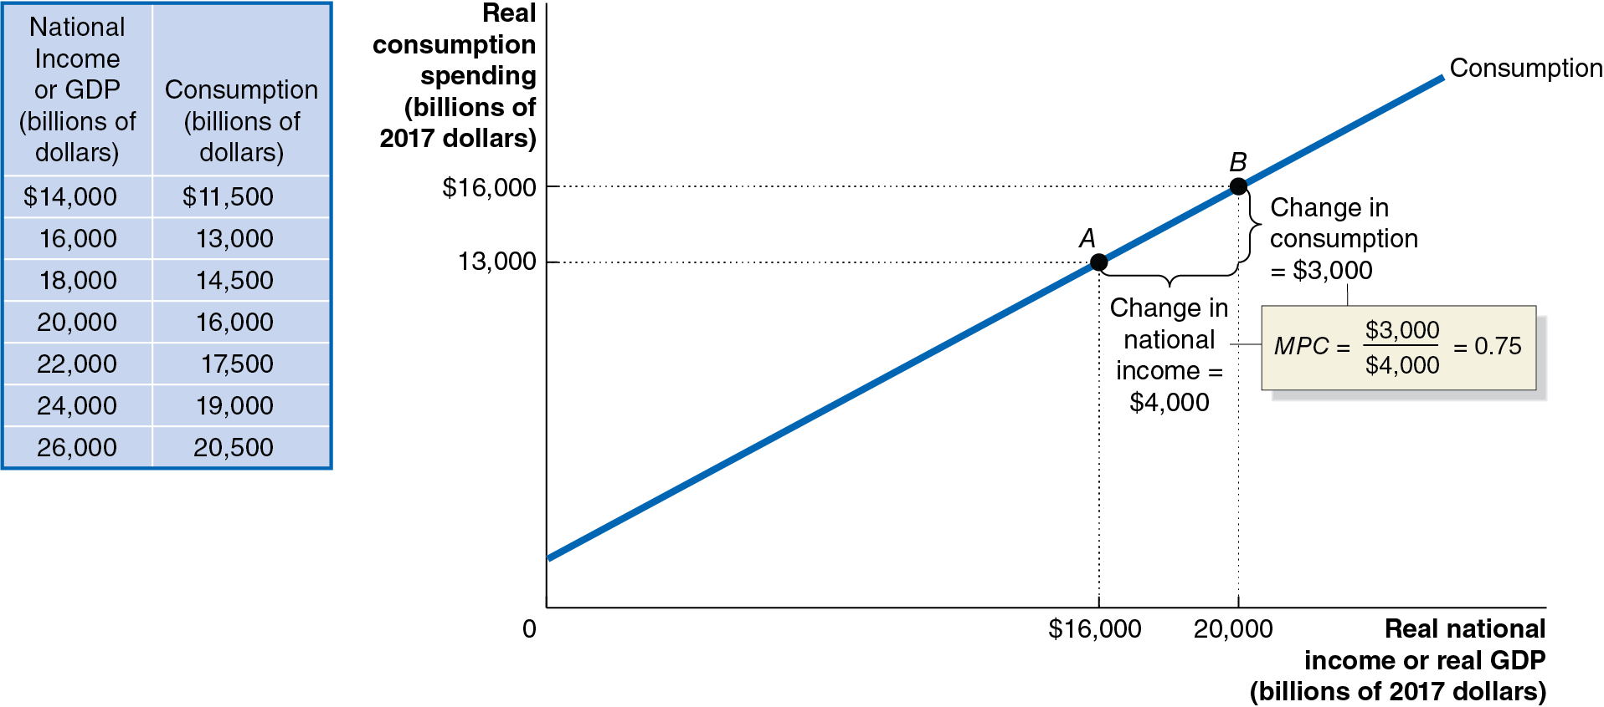
Figure 12.4 The Relationship between Consumption and National Income
The table shows the relationship between consumption and national income for an economy, keeping net taxes constant.
As national income rises by $4,000 billion, consumption rises by $3,000 billion.
So, the marginal propensity to consume for this economy is:
Notes:
The table has 7 rows and 2 columns. The columns have the following headings from left to right: National income or GDP in billions of dollars and Consumption in billions of dollars. The row entries are as follows: Row 1. National income or GDP in billions of dollars, $14,000. Consumption in billions of dollars, $11,500. Row 2. National income or GDP in billions of dollars, 16,000. Consumption in billions of dollars, 13,000. Row 3. National income or GDP in billions of dollars, 18,000. Consumption in billions of dollars, 14,500. Row 4. National income or GDP in billions of dollars, 20,000. Consumption in billions of dollars, 16,000. Row 5. National income or GDP in billions of dollars, 22,000. Consumption in billions of dollars, 17,500. Row 6. National income or GDP in billions of dollars, 24,000. Consumption in billions of dollars, 19,000. Row 7. National income or GDP in billions of dollars, 26,000. Consumption in billions of dollars, 20,500.
On the graph, the X-axis represents real national income or real GDP in billions of 2012 dollars, and the Y-axis represents real consumption spending in billions of 2012 dollars. The line for consumption rises through the graph, intersecting points A (16,000, 13,000), and B (20,000, 16,000). The length between points A and B is the change in national income = to $4,000. The height difference between the points is the chance in consumption = to $3,000. MPC = $3,000 divided by $4,000 = 0.75.

Slide 22
Income, Consumption, and Saving
By definition, disposable income not spent is saved. Therefore
Any change in national income can be decomposed into changes in the items on the right side:
We assume net taxes do not change, so
then
Dividing through by
gives:

Slide 23
Marginal Propensity to Save
is the amount by which savings changes, when (disposable)
income changes. This is known as the marginal propensity to save. We can rewrite the equation above as:
That is, the marginal propensity to consume plus the marginal propensity to save must equal 1.
Part of any increase in income is consumed, and the rest is saved.

Slide 24
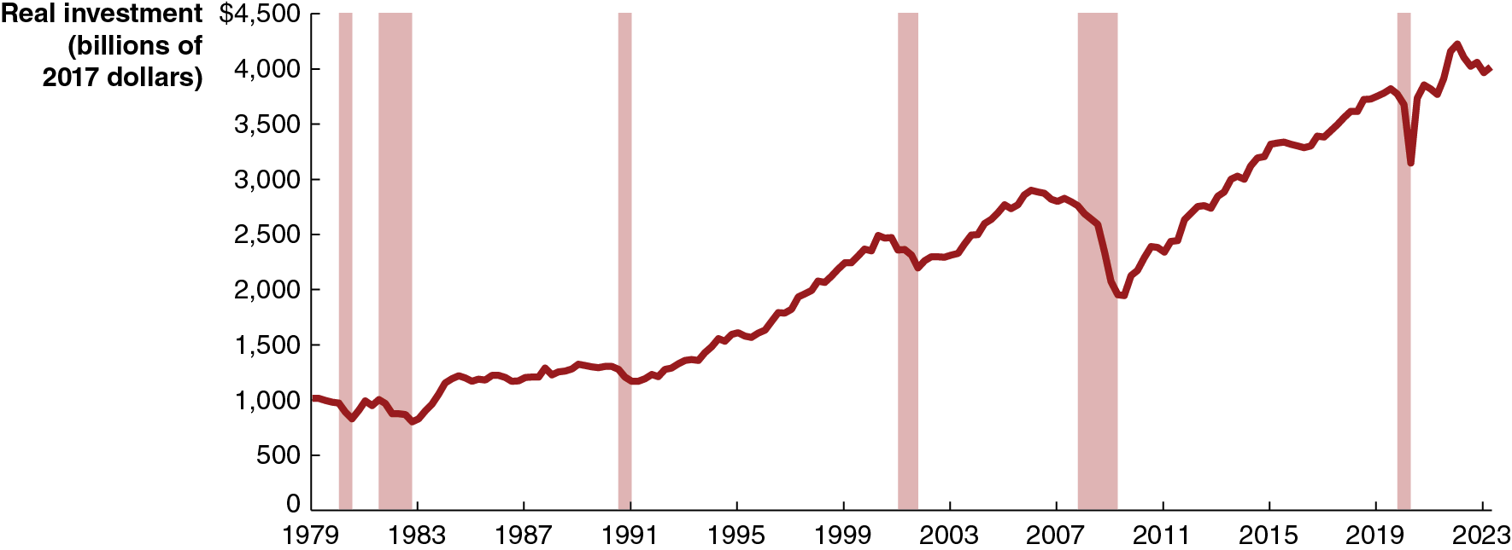
Figure 12.5 Real Investment, 1979-2022
Investment has increased over time; but unlike consumption, it has not increased smoothly, and recessions decrease investment more.
What affects the level of investment?
Expectations of future profitability
The interest rate
Taxes
Cash flow
Notes:
NOTE: In the digital chapter, Figure 12.5 is an interactive real-time data graph, which means it automatically updates when new data becomes available.
The horizontal axis represents year, and ranges from 1979 to 2023, in increments of 5 years. The vertical axis represents real investment in billions of 2017 dollars, and ranges from 0 to $4,500, in increments of 500. The area for recession periods, 1980 to 1981, 1982 to 1983, 1990 to 1991, 2001 to 2002, 2007 to 2009, and 2020 are shaded. The line starts from 1,000 in 1979, falls to 800 in 1983, rises to 2,300 in 2000, falls to 2,000 in 2001, then rises to 2,600 in 2007, and falls to 1,800 in 2009, then rises to 3,500 in 2020, falls to 2,900 in 2020, reaches 4,200 in 2022, and ends at 4,000 in 2023. All values are estimated.

Slide 25
Determinants of Planned Investment (1 of 2)
Expectations of future profitability
Investment goods, such as factories, office buildings, machinery, and equipment, are long-lived. Firms build more of them when they are optimistic about future profitability.
Purchases of new housing are included in planned investment. In recessions, households have reduced wealth and therefore less incentive to invest in new housing.
The interest rate
Since business investment is sometimes financed by borrowing, the real interest rate is an important consideration for investing.
Higher real interest rates result in less investment spending, and lower real interest rates result in more investment spending.

Slide 26
Determinants of Planned Investment (2 of 2)
Taxes
Higher corporate income taxes on profits decrease the money available for reinvestment and decrease incentives to invest by diminishing the expected profitability of investment.
Similarly, investment tax incentives tend to increase investment.
Cash flow
Firms often pay for investments out of their own cash flow, the difference between the cash revenues received by a firm and the cash spending by the firm.
The largest contributor to cash flow is profit. During recessions, profits fall for most firms, decreasing their ability to finance investment.

Slide 27
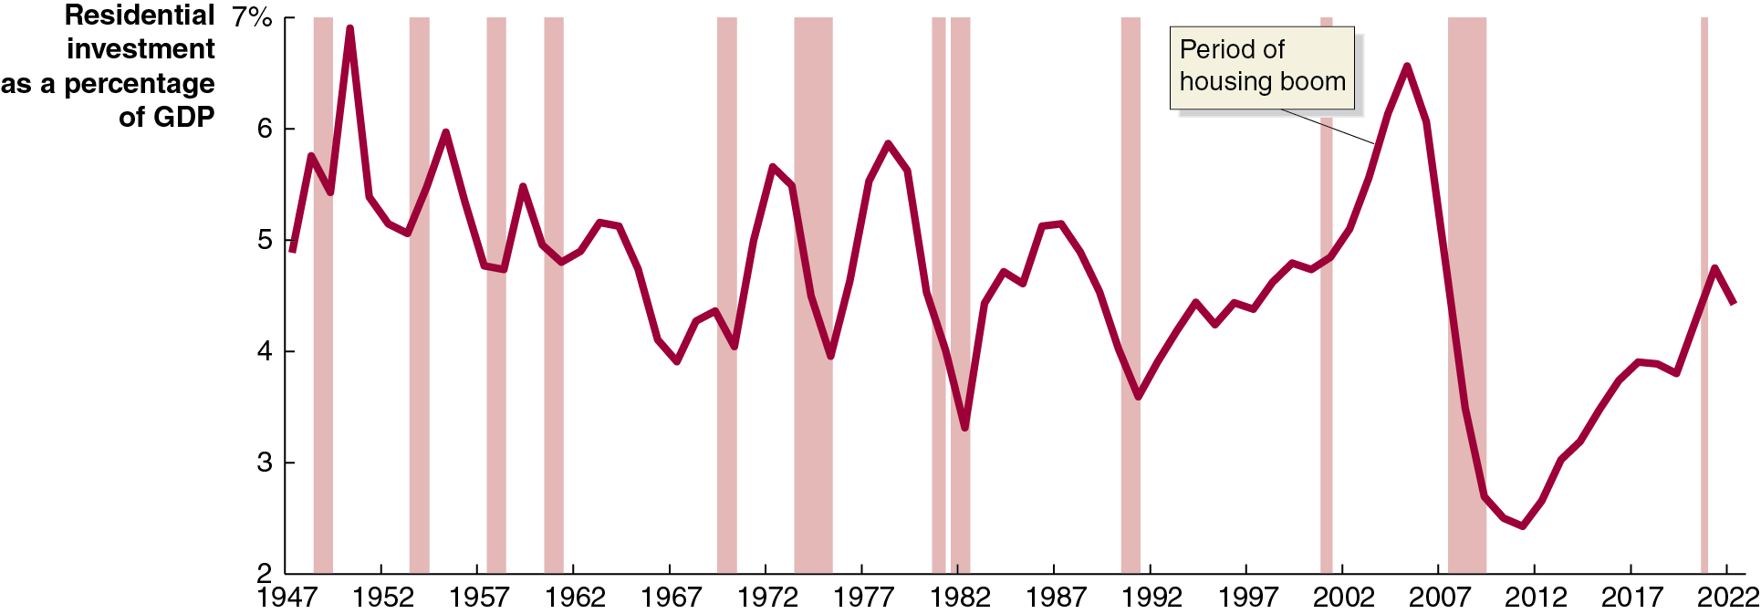
Apply the Concept: Young Buyers Help Boost the Housing Market (1 of 3)
For the period of the economic expansion between 2010 and 2019, residential investment averaged only a little over 3 percent of G D P.
One cause was low home ownership by millennials, caused by factors like high student loan debt, delays in family formation, choosing to live in large cities with high real estate costs, and the slow labor market recovery after the Great Recession.
Notes:
The horizontal axis represents year, and ranges from 1947 to 2022, in increments of 5 years. The vertical axis represents residential investment as a percentage of G D P, and ranges from 2 to 7%, in increments of 1%. The area for recession periods, 1948 to 1949, 1953 to 1954, 1957 to 1958, 1960 to 1961, 1968 to 1970, 1973 to 1975, 1980 to 1981, 1982 to 1983, 1990 to 1991, 2001 to 2002, 2007 to 2009, and 2020 are shaded. The line starts at 4.9 in 1947, peaks to 6.8 in 1950, falls to 5.2 in 1952, rises to 6 in 1955, falls to 4 in 1967, rises to 5.6 in 1972, falls to 3.3 in 1982, rises through period of housing boom to 6.5 in 2006, falls to 2.2 in 2012, rises to 4.6 in 2021, and ends at 4.5 in 2022. All values are estimated.

Slide 28
Apply the Concept: Young Buyers Help Boost the Housing Market (2 of 3)
As the 2020s began, things started to change: the labor market had recovered, and student loan payments had been paused due to the Covid-19 pandemic. Additionally, the rise of remote work increased the desirability of making a permanent home.
In 2023, for the first time, more millennials owned homes than rented them, and homebuying by Generation Z was also increasing.
Notes:
The horizontal axis represents year, and ranges from 1947 to 2022, in increments of 5 years. The vertical axis represents residential investment as a percentage of G D P, and ranges from 2 to 7%, in increments of 1%. The area for recession periods, 1948 to 1949, 1953 to 1954, 1957 to 1958, 1960 to 1961, 1968 to 1970, 1973 to 1975, 1980 to 1981, 1982 to 1983, 1990 to 1991, 2001 to 2002, 2007 to 2009, and 2020 are shaded. The line starts at 4.9 in 1947, peaks to 6.8 in 1950, falls to 5.2 in 1952, rises to 6 in 1955, falls to 4 in 1967, rises to 5.6 in 1972, falls to 3.3 in 1982, rises through period of housing boom to 6.5 in 2006, falls to 2.2 in 2012, rises to 4.6 in 2021, and ends at 4.5 in 2022. All values are estimated.

Slide 29
Apply the Concept: Young Buyers Help Boost the Housing Market (3 of 3)
However since the second half of 2022, home buying had decreased due to sharp increases in mortgage interest rates. Several questions remain, including:
Will mortgage interest rates stay high, or return to 2010s levels?
If student loan repayments return to “normal,” will younger borrowers have greater difficulty buying homes?
Notes:
The horizontal axis represents year, and ranges from 1947 to 2022, in increments of 5 years. The vertical axis represents residential investment as a percentage of G D P, and ranges from 2 to 7%, in increments of 1%. The area for recession periods, 1948 to 1949, 1953 to 1954, 1957 to 1958, 1960 to 1961, 1968 to 1970, 1973 to 1975, 1980 to 1981, 1982 to 1983, 1990 to 1991, 2001 to 2002, 2007 to 2009, and 2020 are shaded. The line starts at 4.9 in 1947, peaks to 6.8 in 1950, falls to 5.2 in 1952, rises to 6 in 1955, falls to 4 in 1967, rises to 5.6 in 1972, falls to 3.3 in 1982, rises through period of housing boom to 6.5 in 2006, falls to 2.2 in 2012, rises to 4.6 in 2021, and ends at 4.5 in 2022. All values are estimated.

Slide 30
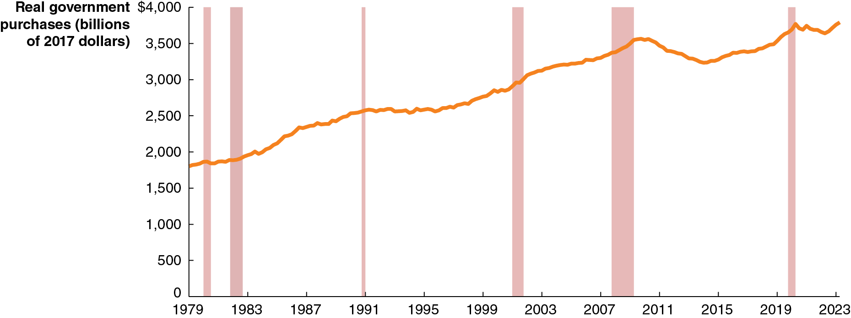
Figure 12.6 Real Government Purchases, 1979–2023
Real government purchases include purchases at all levels of government: federal, state, and local.
Not transfer payments; only purchases for which the government receives some good or service.
Government purchases have generally, though not consistently, increased over time; exceptions include the early 19 90s (end of the Cold War) and after the recession of 2007–2009.
Notes:
NOTE: In the digital chapter, Figure 12.6 is an interactive real-time data graph, which means it automatically updates when new data becomes available.
The horizontal axis represents year, and ranges from 1979 to 2023, in increments of 4 years. The vertical axis represents real government purchases in billions of 2017 dollars, and ranges from 0 to $4,000, in increments of 4 years. The area for recession periods, 1980 to 1981, 1982 to 1983, 1990 to 1991, 2001 to 2002, 2007 to 2009, and 2020 are shaded. The line starts at 1,800 in 1979, rises through 2,500 in 1991, 2,700 in 2000, 3,300 in 2008, falls to 2,800 in 2014, rises to 3,600 in 2020, and ends at 3,700 in 2023. All values are estimated.

Slide 31
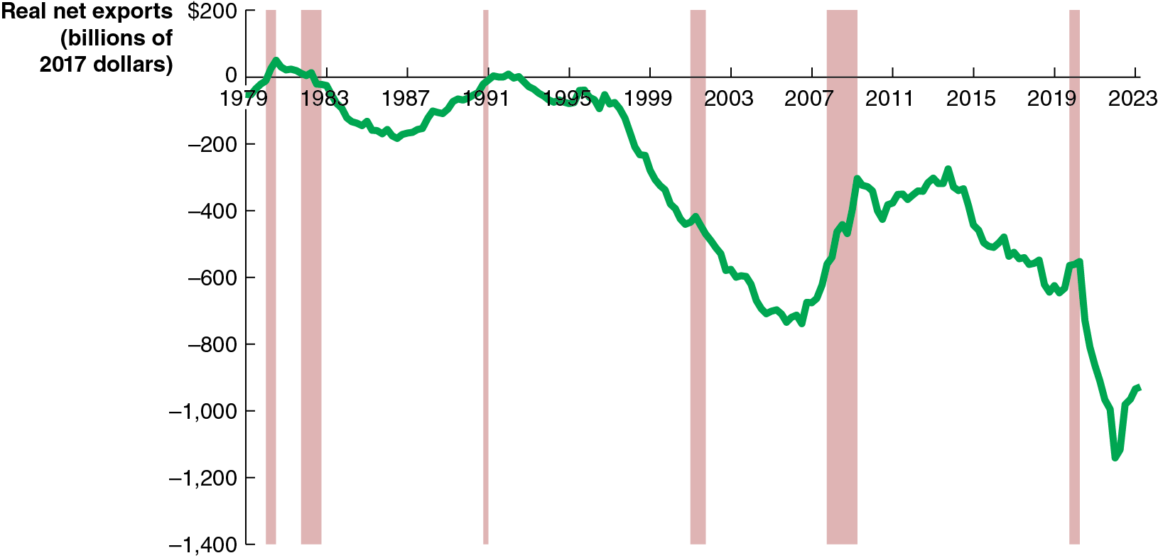
Figure 12.7 Real Net Exports, 1979–2023
Net exports equals exports minus imports; it is affected by:
Price level in United States versus. the price level in other countries
U.S. growth rate versus. growth rate in other countries
U.S. dollar exchange rate
U.S. net exports have been negative for the last few decades. The value typically becomes higher (less negative) during a recession, as spending on imports falls.
Notes:
NOTE: In the digital chapter, Figure 12.7 is an interactive real-time data graph, which means it automatically updates when new data becomes available.
The horizontal axis represents year, and ranges from 1979 to 2023, in increments of 4 years. The vertical axis represents real net exports in billions of 2017 dollars, and ranges from 0 to negative 1,400, in increments of 200. The area for recession periods, 1980 to 1981, 1982 to 1983, 1990 to 1991, 2001 to 2002, 2007 to 2009, and 2020 are shaded. The line starts at negative 10 in 1979, rises to 10 in 1980, falls to negative 210 in 1987, rises to 0 in 1992, falls to negative 700 in 2007, rises to negative 380 in 2009, falls to negative 640 in 2019, rises to negative 580 in 2020, falls to negative 1,100 in 2022, and rises to negative 960 in 2023. All values are estimated.

Slide 32
Determinants of Net Exports
If… | U.S. Net Exports will… | …because…
…U.S. price level rises faster than foreign price levels… | decrease | U.S. goods become more expensive relative to foreign goods, so imports rise and exports fall.
…slower… | increase | The opposite is true.
…U.S. G D P grows faster than foreign G D P… | decrease | U.S. demand for imports rises faster than foreign demand for our exports.
…slower… | increase | The opposite is true.
…$U S rises in value relative to other currencies… | decrease | Imports are cheaper, and our exports are more expensive. So imports rise and exports fall.
…falls… | increase | The opposite is true.

Slide 33

Apply the Concept: The iPhone Is Made in China… or Is It?
When an iPhone is shipped from China to the United States, G D P
statistics register a
import from China to the United States.
But iPhones are only assembled in China; no Chinese firm makes any of the iPhone’s components.
Only 4 percent of the value of the iPhone should be attributed to the assembly, according to one study.
Pascal Lamy of the W T O: “The concept of country of origin for manufactured goods has gradually become obsolete.”

Slide 34
12.3 Graphing Macroeconomic Equilibrium
Use a
-line diagram to illustrate macroeconomic equilibrium.
Suppose in the whole economy there is a single product: Pepsi.
For the Pepsi economy to be in equilibrium, the amount of Pepsi produced must equal the amount of Pepsi sold.
Otherwise, inventories of Pepsi rise or fall.

Slide 35
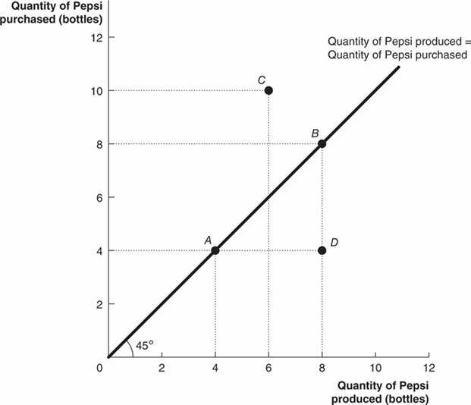
Figure 12.8 An Example of a 45 degrees -Line Diagram
Any point on the
line could be
an equilibrium—like points A or B.
At point C, the economy’s inventories of Pepsi are being depleted, and production must rise to restore equilibrium.
At point D, inventories of Pepsi are growing, so production must fall.
Notes:
The X axis represents quantity of Pepsi produced in bottles, and the Y axis represents quantity of Pepsi purchased in bottles. The line for quantity of Pepsi produced = quantity of Pepsi purchased, rises at a 45 degree angle from the origin across the graph. The line intersects points A (4, 4), and B (8, 8), with points C (6, 10) and D (8, 4) as outliers.

Slide 36
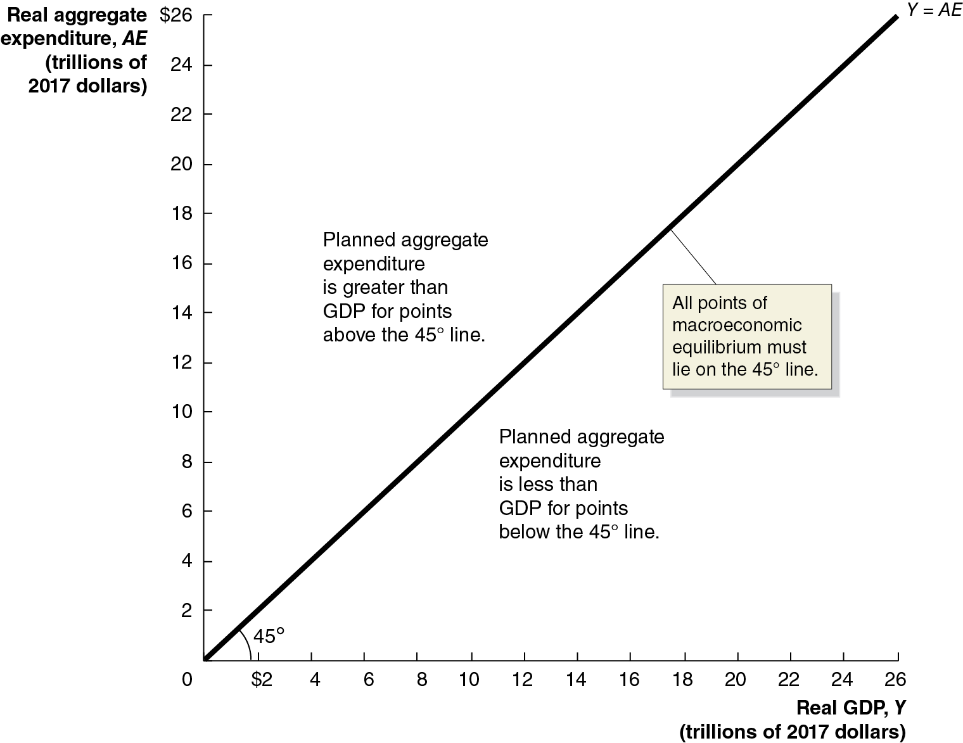
Figure 12.9 The Relationship between Planned Aggregate Expenditure and G D P on a 45 degrees -Line Diagram
We can apply this model to a real economy, with real national income (G D P) on the x-axis and real aggregate expenditure on the y-axis.
This model is also known as the Keynesian cross.
Only points on the
line
can be a macroeconomic equilibrium, with planned aggregate expenditure equal to G D P.
Notes:
The horizontal axis represents real G D P, Y, in trillions of 2017 dollars, and ranges from 0 to $26, in increments of 2. The vertical axis represents real aggregate expenditure, A E, in trillions of 2017 dollars, and ranges from 0 to $26, in increments of 2. The 45 degree line Y = A E rises from the origin through the point (20, 20), to the upper right corner. All points of macroeconomics equilibrium must lie on the 45 degree line. Planned aggregate expenditure is greater than G D P for points above the 45 degree line. Planed aggregate expenditure is less than G D P for points below the 45 degree line.

Slide 37
Determining the Macroeconomic Equilibrium
Any point on the
-line could be an equilibrium, but how do we know
which one will be the equilibrium in a given year?
To determine this, recall that when they receive additional income, households consume some of it and save some of it.
The resulting consumption function tells us how much consumers will spend (real expenditure) when they have a particular income (real G D P).
This will determine Consumption (C) in the equation
Macroeconomic equilibrium simply means the left side (real G D P) must equal the right side (planned aggregate expenditure).
The trick is to find the “right” level of C. For that, we use the
line diagram.

Slide 38
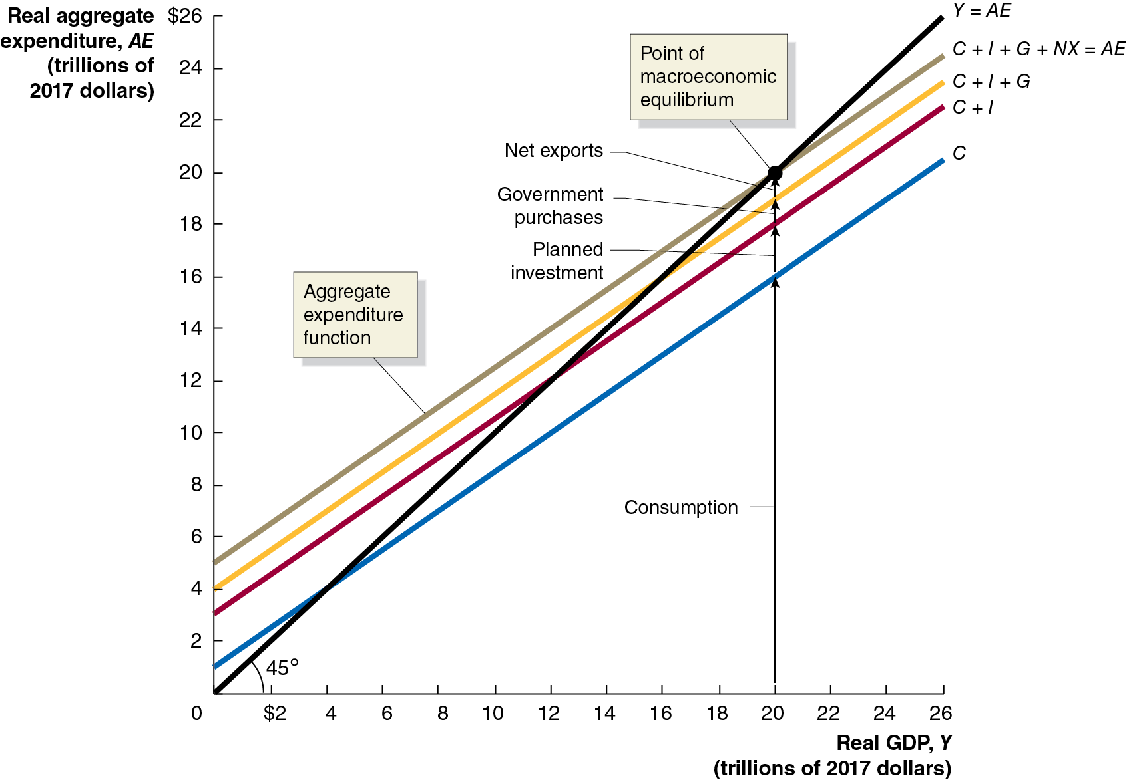
Figure 12.10 Macroeconomic Equilibrium on the 45 degrees -Line Diagram (1 of 3)
We start by placing the consumption function on the diagram.
If there was no other expenditure in the economy, then the macroeconomic equilibrium would be where the consumption
function crossed the
line; there, income (G D P) equals expenditure.
Notes:
The horizontal axis represents real G D P, Y, in trillions of 2017 dollars, and ranges from 0 to $26, in increments of 2. The vertical axis represents real aggregate expenditure, A E, in trillions of 2017 dollars, and ranges from 0 to $26, in increments of 2. The 45 degree line Y = A E rises from the origin through the point (20, 20), to the upper right corner. A vertical line at real G D P, 20 represents consumption, and intersects with Y = A E at (20, 20), the point of macroeconomic equilibrium. Blue line C intersects with Y = A E at (4, 4). Red line C + I intersects Y = A E at (12, 12). Yellow line C + I + G intersects Y = A E (16, 16). Green line C + I + G + N X = A E, represents aggregate expenditure function, and intersects Y = A E at (20, 20). The distance between lines C and C + I is the planned investment, the distance between C + I and C + I + G is government purchases, and the distance between C + I + G and C + I + G + N X = A E is net exports. All values are estimated.

Slide 39
Figure 12.10 Macroeconomic Equilibrium on the 45 degrees -Line Diagram (2 of 3)
But there are other expenditures. We will assume they are not affected by income, that they are predetermined.
Then we add the other expenditures: planned investment, government purchases, and net exports.
These are vertical shifts in real expenditure because their values do not depend on real G D P.
Notes:
The horizontal axis represents real G D P, Y, in trillions of 2017 dollars, and ranges from 0 to $26, in increments of 2. The vertical axis represents real aggregate expenditure, A E, in trillions of 2017 dollars, and ranges from 0 to $26, in increments of 2. The 45 degree line Y = A E rises from the origin through the point (20, 20), to the upper right corner. A vertical line at real G D P, 20 represents consumption, and intersects with Y = A E at (20, 20), the point of macroeconomic equilibrium. Blue line C intersects with Y = A E at (4, 4). Red line C + I intersects Y = A E at (12, 12). Yellow line C + I + G intersects Y = A E (16, 16). Green line C + I + G + N X = A E, represents aggregate expenditure function, and intersects Y = A E at (20, 20). The distance between lines C and C + I is the planned investment, the distance between C + I and C + I + G is government purchases, and the distance between C + I + G and C + I + G + N X = A E is net exports. All values are estimated.

Slide 40
Figure 12.10 Macroeconomic Equilibrium on the 45 degrees -Line Diagram (3 of 3)
At last, we have macroeconomic equilibrium: the point at which
Income equals expenditure, that is,
The level of consumption is consistent with the level of income, according to the consumption function.
We call this top-most line the aggregate expenditure function.
Notes:
The horizontal axis represents real G D P, Y, in trillions of 2017 dollars, and ranges from 0 to $26, in increments of 2. The vertical axis represents real aggregate expenditure, A E, in trillions of 2017 dollars, and ranges from 0 to $26, in increments of 2. The 45 degree line Y = A E rises from the origin through the point (20, 20), to the upper right corner. A vertical line at real G D P, 20 represents consumption, and intersects with Y = A E at (20, 20), the point of macroeconomic equilibrium. Blue line C intersects with Y = A E at (4, 4). Red line C + I intersects Y = A E at (12, 12). Yellow line C + I + G intersects Y = A E (16, 16). Green line C + I + G + N X = A E, represents aggregate expenditure function, and intersects Y = A E at (20, 20). The distance between lines C and C + I is the planned investment, the distance between C + I and C + I + G is government purchases, and the distance between C + I + G and C + I + G + N X = A E is net exports. All values are estimated.

Slide 41
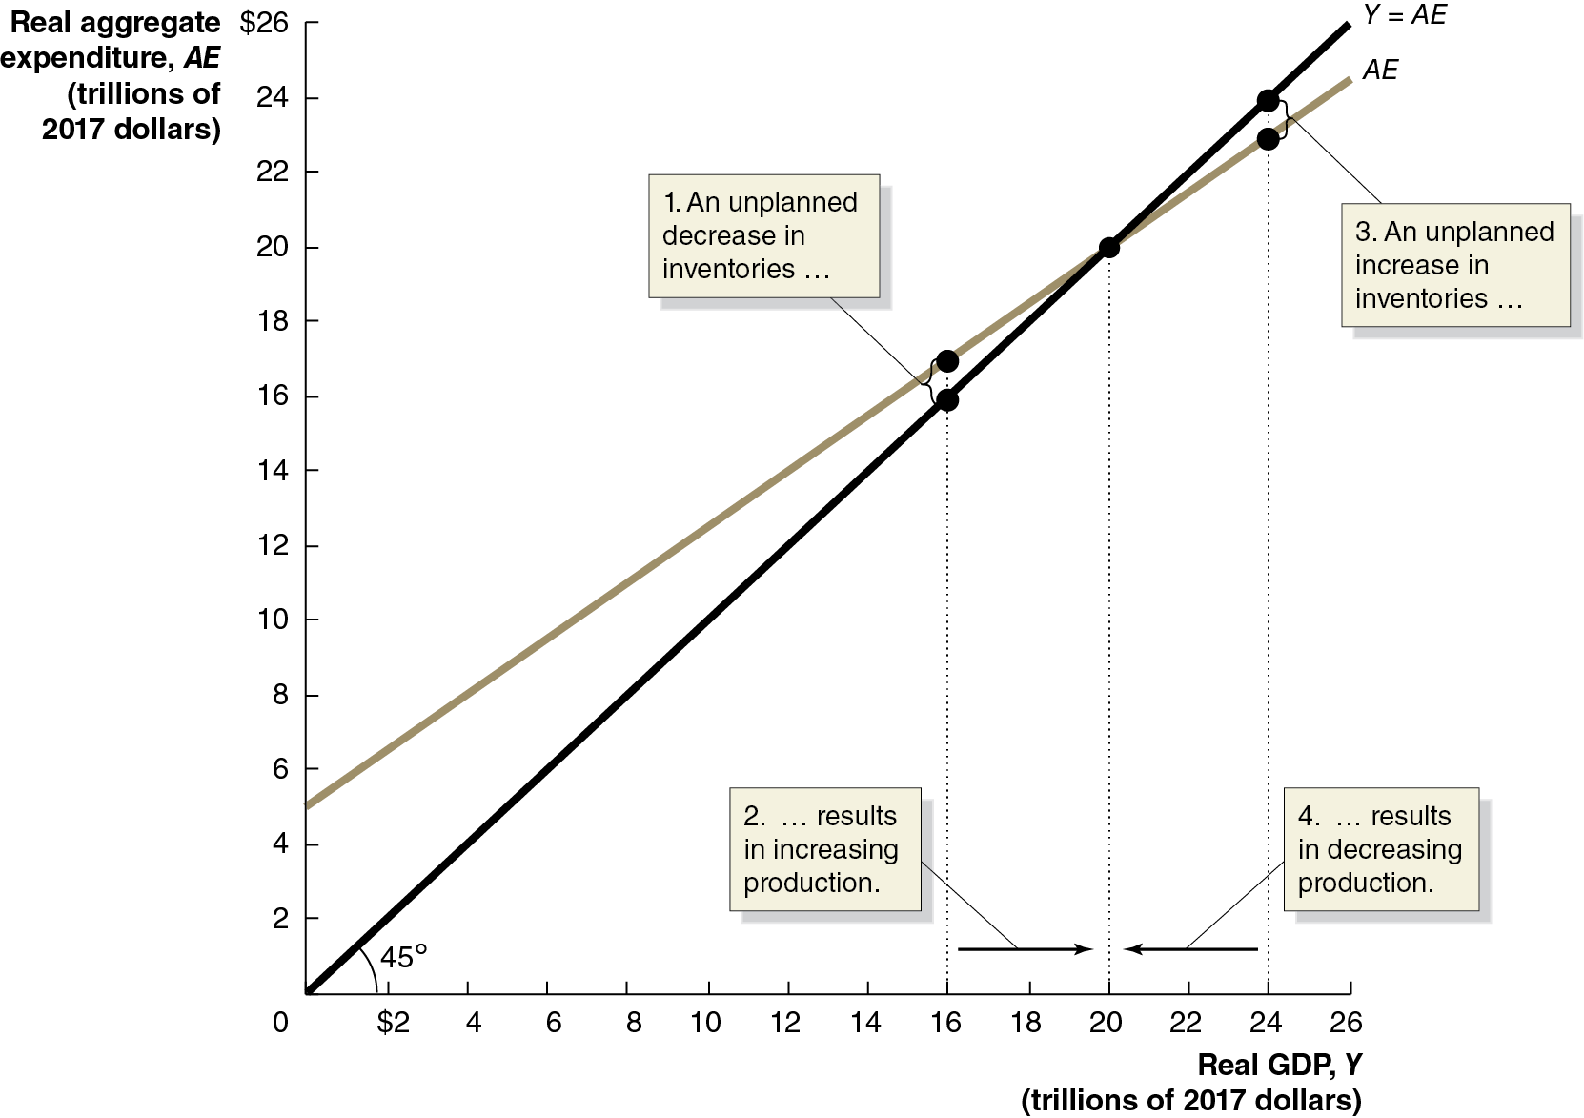
Figure 12.11 Macroeconomic Equilibrium
In this economy, macroeconomic equilibrium occurs at $20 trillion.
What if real G D P were lower, say $16 trillion?
Aggregate expenditure would be higher than G D P, so inventories would fall.
This would signal firms to increase production, increasing G D P.
The reverse would occur if real G D P were above $20 trillion.
Notes:
The horizontal axis represents real G D P, Y, in trillions of 2017 dollars, and ranges from 0 to $26, in increments of 2. The vertical axis represents real aggregate expenditure, A E, in trillions of 2017 dollars, and ranges from 0 to $26, in increments of 2. The 45 degree line Y = A E rises from the origin through the points (16, 16), (20, 20), and (24, 24). Line A E starts at (0, 5), and rises through the points (16, 17), (20, 20), and (24, 22). The distance between points (16, 16) and (16, 17) is an unplanned decrease in inventories, resulting in an increase in production. The distance between points (24, 22) and (24, 24) is an unplanned increase in inventories, resulting in decreasing production. All values are estimated.

Slide 42
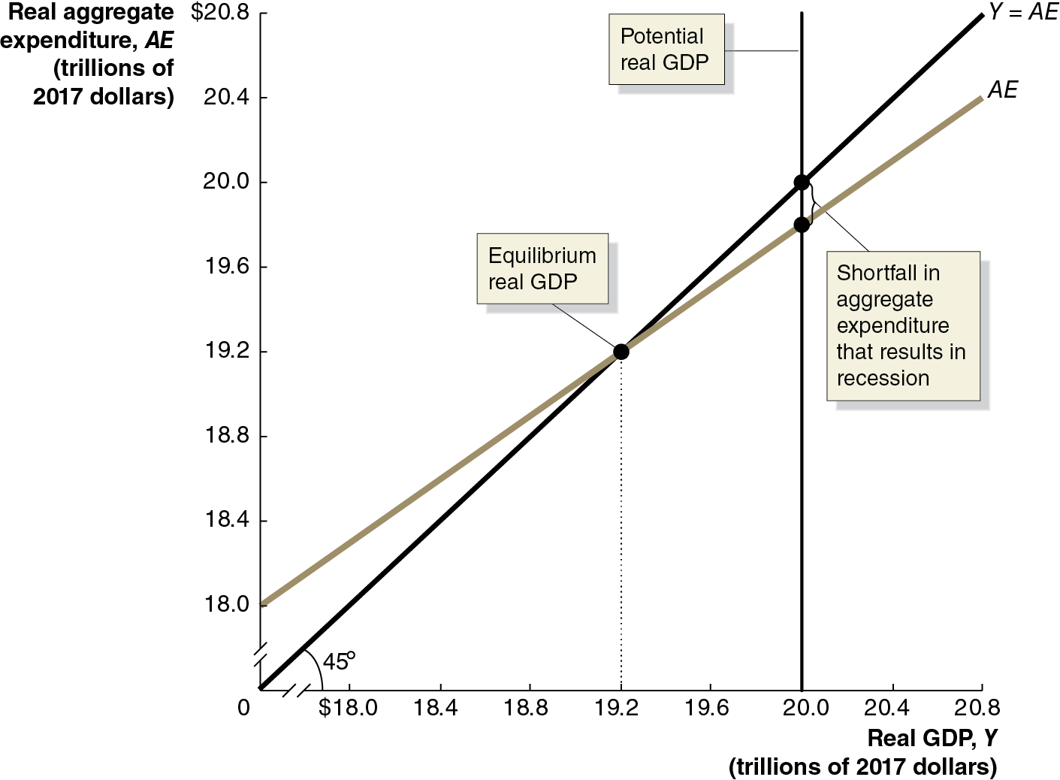
Figure 12.12 Showing a Recession on the 45 degrees -Line Diagram
Macroeconomic equilibrium can
occur anywhere on the
line. Ideally, we would like it to occur at the level of potential G D P.
If equilibrium occurs at this level, unemployment will be low—at the natural rate of unemployment or the full employment level.
But this might not occur; maybe firms are pessimistic and reduce investment spending.
Then the equilibrium will occur below potential G D P—a recession.
Notes:
The horizontal axis represents real G D P, Y, in trillions of 2017 dollars, and ranges from 0 to $20.8, in increments of 0.4, with a kink between 0 and $18.0. The vertical axis represents real aggregate expenditure, A E, in trillions of 2017 dollars, and ranges from 0 to $20.8 in increments of 0.4, with a kink between 0 and $18. The 45 degree line Y = A E rises from the origin to the upper right corner. A vertical line at real G D P, 20.0 represents potential real G D P. Line A E subscript 1 rises from (0, 18.0) to (20.8, 20.2). Line A E intersects with line Y = A E at (19.2, 19.2), the equilibrium real G D P. Line A E intersects potential real G D P at (20.0, 19.8), and line Y = A E intersects potential real G D P at (20.0, 20.0). The distance between the points (20.0, 19.8), and (20.0, 20.0), represents the shortfall in aggregate expenditure that results in recession. All values are estimated.

Slide 43
The Important Role of Inventories
Inventories play a critical role in this model of the economy.
When planned aggregate expenditure is less than real G D P, firms will experience unplanned increases in inventories.
Then even if spending returns to normal levels, firms have excess inventories to sell, and they will do this instead of increasing production to normal levels.
Example: In 2009, the Great Recession was about to end. But real G D P fell sharply in the first quarter of 2009—at a 4.5 percent annualized rate.
Economists estimate that almost half of this decline was due to firms cutting production as they sold off their unintended accumulation of inventories.

Slide 44
Table 12.4 Macroeconomic Equilibrium
Real G D P (Y) | Consumption (C) | Planned Investment (I) | Government Purchases (G) | Net Exports (N X) | Planned Aggregate Expenditure (A E) | Unplanned Change in Inventories | Real G D P Will…
$18,000 | $14,500 | $2,500 | $2,500 | negative $1000 | $18,500 | negative $500 | Increase.
19,000 | 15,250 | 2,500 | 2,500 | negative 1000 | 19,250 | negative 250 | Increase.
20,000 | 16,000 | 2,500 | 2,500 | negative 1000 | 20,000 | 0 | be in equilibrium.
21,000 | 16,750 | 2,500 | 2,500 | negative 1000 | 20,750 | 250 | decrease.
22,000 | 17,500 | 2,500 | 2,500 | negative 1000 | 21,500 | 500 | decrease.
The table shows several hypothetical combinations of real G D P and planned aggregate expenditure.
As real G D P changes, consumption changes but planned investment, government purchases, and net exports stay constant.
Macroeconomic equilibrium can occur only at $20,000 billion; otherwise, the unplanned change in inventories will cause firms to change production and hence real G D P will change.

Slide 45
12.4 The Multiplier Effect
Describe the multiplier effect and use the multiplier formula to calculate changes in equilibrium G D P.
You may have noticed that a small change in planned aggregate expenditure causes a larger change in equilibrium real G D P.
In our model, planned investment, government purchases, and net exports are autonomous expenditures: expenditures that do not depend on the level of G D P.
But, consumption has both an autonomous and induced effect.
So, its level does depend on the level of G D P, and this produces the upward-sloping A E line.

Slide 46
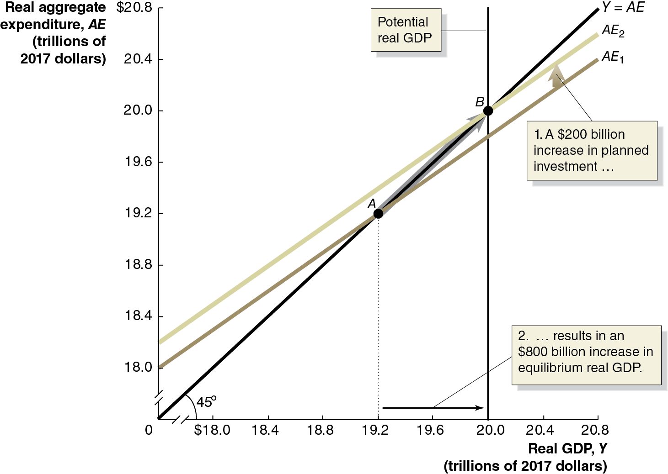
Figure 12.13 The Multiplier Effect
An increase in an autonomous expenditure shifts the aggregate expenditure line upward.
When this happens, real G D P increases by more than the change in autonomous expenditures; this is the multiplier effect.
The change in equilibrium real G D P divided by the change in autonomous expenditures is the multiplier.
Notes:
The horizontal axis represents real G D P, Y, in trillions of 2017 dollars, and ranges from 0 to $20.8, in increments of 0.4, with a kink between 0 and $18.0. The vertical axis represents real aggregate expenditure, A E, in trillions of 2017 dollars, and ranges from 0 to $20.8 in increments of 0.4, with a kink between 0 and $18. The 45 degree line Y = A E rises from the origin to the upper right corner. A vertical line at real G D P, 20.0 represents potential real G D P. Line A E subscript 1 rises from (0, 18.0) to (20.8, 20.2). Line A E subscript 1 shifts up, and becomes line A E subscript 2, a $200 billion increase in planned investment, resulting in an $800 billion increase in equilibrium real G D P. Line A E subscript 1 intersects Y = A E at point A (19.2, 19.0). Line A E subscript 2 intersects Lines Y = A E and potential real G D P at point B at (20.0, 20.0). All values are estimated

Slide 47
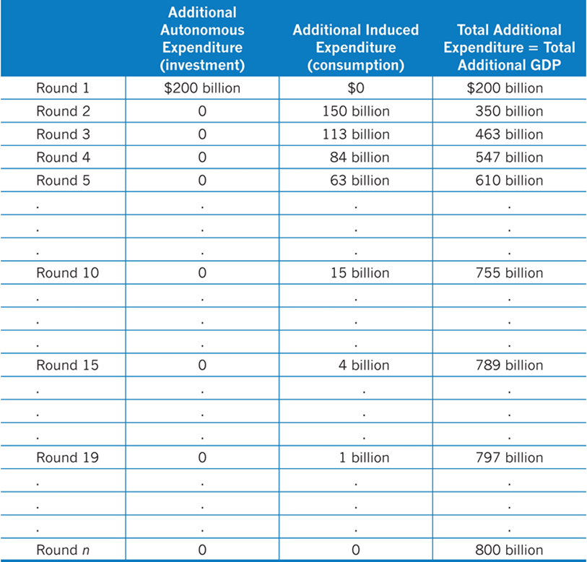
Table 12.5 The Multiplier Effect in Action
Initially, real G D P rises by the amount of the increase in autonomous expenditure.
This causes an increase in real G D P, which causes an increase in production, which causes an increase in real G D P, and so on.
Notes:
The table has 4 columns and 21 rows. The column headings from left to right are as follows. Blank. Additional autonomous expenditure, or investment. Additional induced expenditure, or consumption. Total additional expenditure = total additional G D P. The rows entries are as follows. All data is given in dollars.
Row 1. Round 1, 200 billion, 0, 200 billion.
Row 2. Round 2, 0, 150 billion, 350 billion.
Row 3. Round 3, 0, 113 billion, 463 billion.
Row 4. Round 4, 0, 84 billion, 547 billion.
Row 5. Round 5, 0, 63 billion, 610 billion.
Row 6 to Row 8 are blank.
Row 9. Round 10, 0, 15 billion, 755 billion.
Row 10 to Row 12 are blank.
Row 13. Round 15, 0, 4 billion, 789 billion.
Row 14 to Row 16 are blank.
Row 17. Round 19, 0, 1 billion, 797 billion.
Row 18 to Row 20 are blank.
Rowe 21. Round n, 0, 0, 800 billion.

Slide 48
Eventual Effect of the Multiplier
We cannot say how long this adjustment to macroeconomic equilibrium will take—how many “rounds,” back and forth.
But we can calculate the value of the multiplier, as the eventual change in real G D P divided by the change in autonomous expenditures (planned investment, in this case):
With a multiplier of 4, each $1 increase in planned investment (or any other autonomous expenditure) eventually increases equilibrium real G D P by $4.

Slide 49

Apply the Concept: The Multiplier in Reverse: the Great Depression (1 of 2)
The multiplier can work in reverse too, like it did during the Great Depression of the 1930s.
Several events, including the stock market crash of October 1929, led to reductions in investments by firms.
Real G D P fell, so consumers cut back on spending, prompting firms to reduce production more, so consumers spent even less….
Year | Consumption | Investment | Exports | Real G D P | Unemployment Rate
1929 | $881 billion | $125 billion | $42 billion | $1,191 billion | 2.9%
1933 | $719 billion | $28 billion | $23 billion | $877 billion | 20.9%

Slide 50
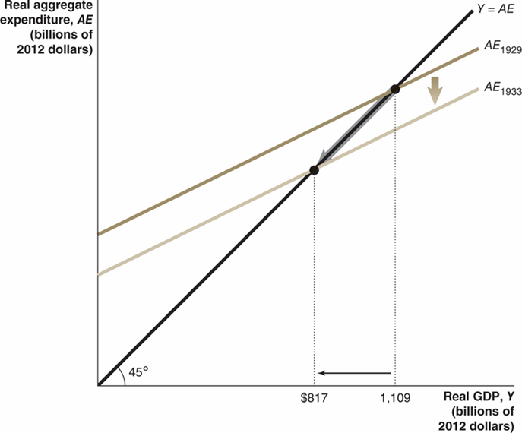
Apply the Concept: The Multiplier in Reverse: the Great Depression (2 of 2)
The
-line diagram can help
to illustrate this process.
Aggregate expenditures fell initially, due to the decrease in investment.
This prompted a multiplied effect on equilibrium real G D P.
Recovery from the Great Depression took many years; unemployment remained above 10 percent until
Notes:
The X axis represents real G D P, Y, in trillions of 2012 dollars, and the Y axis represents real aggregate expenditure, A E, in trillions of 2012 dollars. 45 degree line Y = A E rises from the origin across the graph. Line A E sub 1929 shifts down and becomes A E sub 1933. Line Y = A E intersects A E sub 1933 at 817 and A E sub 1929 at 1,109.

Slide 51
The Multiplier and the Marginal Propensity to Consume
How can we know the eventual value of the multiplier?
In each “round,” the additional income prompts households to consume some fraction (the marginal propensity to consume).
The total change in equilibrium real G D P equals:
The initial increase in planned investment spending
Plus the first induced increase in consumption
Plus the second induced increase in consumption
Plus the third induced increase in consumption
And so on…

Slide 52
A Formula for the Multiplier
This becomes the infinite sum:
Total change in G D P
In our case, M P C = 0.75, so the multiplier is
A $200 billion increase in investment eventually results in a $800 billion increase in equilibrium real G D P.
The general formula for the multiplier is

Slide 53
Summarizing the Multiplier Effect
The multiplier effect occurs both for an increase and a decrease in planned aggregate expenditure.
Because the multiplier is greater than 1, the economy is sensitive to changes in autonomous expenditure.
The larger the M P C, the larger the value of the multiplier.
Our model is somewhat simplified, omitting some real-world complications. For example, as real G D P changes, imports, inflation, interest rates, and income taxes will change.
The last point generally means that the value we estimate for the multiplier, from the M P C, is too high. In Chapter 23, we will address some of these shortcomings.

Slide 54
The Paradox of Thrift
Recall the savings identity: savings equals investment.
This implied that savings were the key to long-term growth.
In the short term, if people save more, then consumption decreases, and hence incomes decrease, so consumption decreases… potentially pushing the economy into recession.
John Maynard Keynes referred to this as the paradox of thrift: what appears to be favorable in the long run may be counterproductive in the short run.
Economists debate whether this paradox of thrift really exists; increasing savings decreases the real interest rate; the consequent increase in investment spending may offset the decrease in consumption spending.
We cannot settle this with our simple model.

Slide 55
12.5 The Aggregate Demand Curve
Understand the relationship between the aggregate demand curve and aggregate expenditure.
As demand for a product rises, we expect that two things will occur: production will increase and so will the product’s price.
Our model has concentrated on the first of these, but what about price changes?
In the larger economy, we also expect that an increase in aggregate expenditure would increase the price level.
Will this price level change have a feedback effect on aggregate expenditures?
We generally expect that it will: increases in the price level will cause aggregate expenditure to fall; and decreases in the price level will cause aggregate expenditures to rise.

Slide 56
How Does the Price Level Affect Aggregate Expenditures?
The price level affects aggregate expenditures in three ways:
Rising price levels decrease the real value of household wealth, causing consumption to fall.
If price levels rise in the United States faster than in other countries, U.S. exports fall and imports rise, causing net exports to fall.
When prices rise, firms and households need more money to finance buying and selling. If the supply of money doesn’t change, the interest rate must rise; this will cause investment spending to fall.
Of course, these effects work in reverse if the price level falls.
Each effect works in the same direction, so rising price levels decrease aggregate expenditures, while falling price levels increase aggregate expenditures.

Slide 57
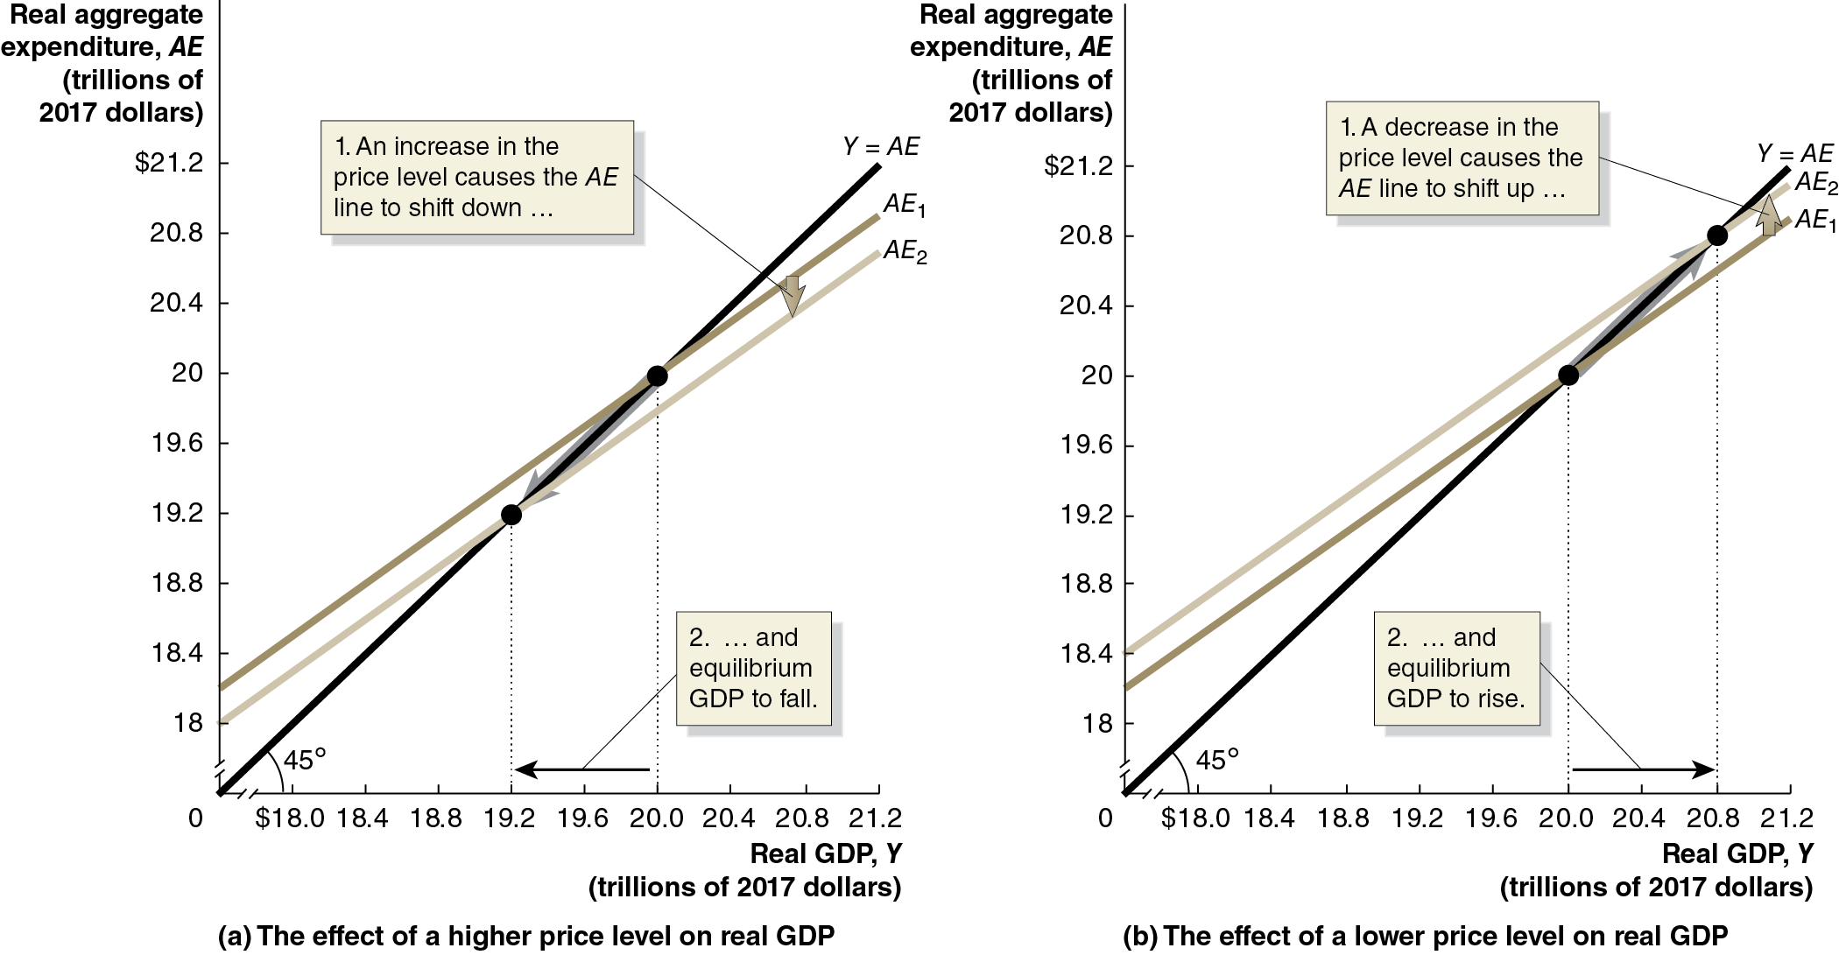
Figure 12.14 The Effect of a Change in the Price Level on Real G D P
The diagrams show the effects described on the previous slide:
Panel (a): Increases in the price level cause A E and real G D P to fall.
Panel (b): Decreases in the price level cause A E and real G D P to rise.
Notes:
On both graphs, the horizontal axis represents real G D P, Y, in trillions of 2017 dollars, and ranges from 0 to $21.2, in increments of 0.4, with a kink between 0 and $18.0. The vertical axis represents real aggregate expenditure, A E, in trillions of 2017 dollars, and ranges from 0 to $21.2 in increments of 0.4, with a kink between 0 and $18. The 45 degree line Y = A E rises from the origin to the upper right corner. (a) The graph depicts the effect of a higher price level on real G D P. Line A E subscript 1 starts at (0, 18.2), and rises to (21.2, 20.8). Line A E subscript 1 shifts down and becomes line A E subscript 2. An increase in the price level causes the A E line to shift down, and the equilibrium G D P to fall. Line Y = A E intersects line A E subscript 2 at (19.2, 19.0), and line A E subscript 1 at (20.0, 20.0).
(b) The graph depicts the effect of a lower price level on real G D P. Line A E subscript 1 starts at (0, 18.2), and rises to (21.2, 20.8). Line A E subscript 1 shifts up and becomes A E subscript 2. A decrease in the price level causes A E line to shift up, and the equilibrium G D P to rise. Line Y = A E intersects line A E at (20.0, 20), and A E subscript 2 at (20.8, 20.8). All values are estimated.

Slide 58
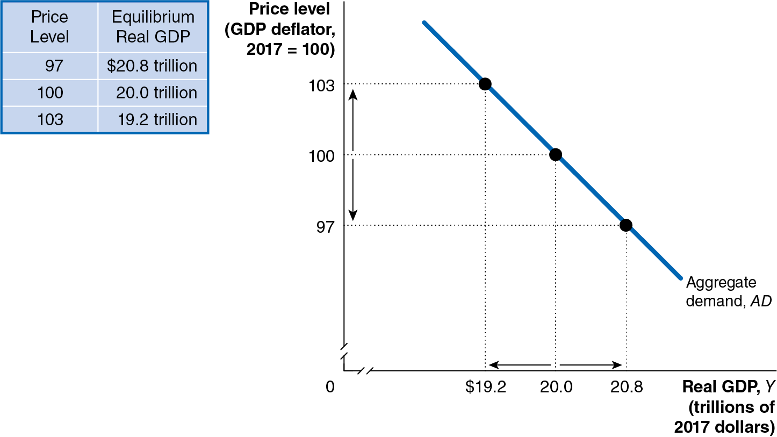
Figure 12.15 The Aggregate Demand Curve
Consequently, there is an inverse relationship between the price level and real G D P.
This relationship is known as the aggregate demand curve.
Aggregate demand (A D) curve: A curve that shows the relationship between the price level and quantity of real G D P demanded by households, firms, and the government (both inside and outside the country).
Notes:
The data from the table is as follows. • Price level, 97. Equilibrium real G D P, $20.8 trillion. • Price level, 100. Equilibrium real G D P, 20.0 trillion. • Price level, 103. Equilibrium real G D P, 19.2 trillion. The graph depicts the aggregate demand curve. The horizontal axis represents real G D P, Y, in trillions of 2017 dollars, and ranges from 0 to 20.8, with a kink near the origin. The vertical axis represents price level in G D P deflator, 2017 = 100, with a kink near the origin. The line for aggregate demand, A D falls through the points (19.2, 103), (20.0, 100), and (20.8, 97).

Slide 59
Appendix: The Algebra of Macroeconomic Equilibrium
Apply the algebra of macroeconomic equilibrium.
Graphical analysis of macroeconomic equilibrium can tell us the qualitative changes that take place.
But an equation-based model can allow us to make quantitative or numerical estimates of what will occur.
Economists in universities, firms, and the government rely on econometric models in which they statistically estimate the relationships between economic variables.

Slide 60
Aggregate Expenditure Equations
Based on the example in the text, we can generate the following equations (changing the M P C so as to generate different results):
Consumption function:
Planned Investment function:
Government purchases function:
Net export function:
Equilibrium condition
In using the model, researchers would estimate the parameters of the model—such as the M P C or the values of the autonomous expenditure components like planned investment—using statistical methods and years of observations of data.

Slide 61
Solving the Model
The first four equations can be used to form the aggregate expenditure function—the right-hand side of the fifth equation.
The fifth equation is the essential “equilibrium condition,” representing
the effect of the
line.
Substituting the first four equations into the fifth gives:
Subtracting 0.65Y from both sides gives:
Which simplifies to:

Slide 62
General Aggregate Expenditure Equations
More generally, we could allow the parameters of the model to be represented by letters:
Consumption function:
Planned Investment function:
Government purchases function:
Net export function:
Equilibrium condition:
The letters with bars over them are parameters—fixed (autonomous) values.

Slide 63
Solving the General Aggregate Expenditure Equations
Solving now for equilibrium, we get:
The last equation makes clear that:

Slide 64

Copyright
This work is protected by United States copyright laws and is provided solely for the use of instructors in teaching their courses and assessing student learning. Dissemination or sale of any part of this work (including on the World Wide Web) will destroy the integrity of the work and is not permitted. The work and materials from it should never be made available to students except by instructors using the accompanying text in their classes. All recipients of this work are expected to abide by these restrictions and to honor the intended pedagogical purposes and the needs of other instructors who rely on these materials.

